Slide 1

React Native on the Universal Windows Platform
Eric Rozell, Erik Schlegel
@ericrozell, @erikschlegel1

Slide 2
What is React?
var HelloWorld = React.createClass({
render: function() {
return (
<p>
Hello, <input type="text" placeholder="Your name here" />!
It is {this.props.date.toTimeString()}
</p>
);
}
});
setInterval(function() {
ReactDOM.render(
<HelloWorld date={new Date()} />,
document.getElementById('example')
);
}, 500);
Notes:
What makes react appealing?
- “The ‘V’ in MVC”
- Declarative UI
- Composability
- Shadow DOM

Slide 3
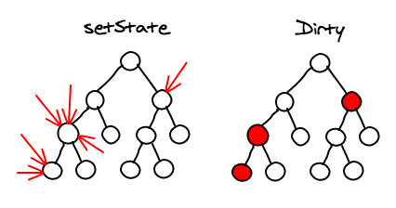
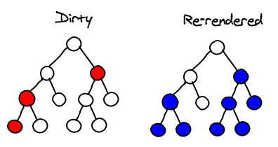
What is React?
Images Credit: @vjeux
Notes:
isomorphic

Slide 4
What is React Native?
“React Native enables you to build world-class application experiences on native platforms using a consistent developer experience based on JavaScript and React.”
Notes:
Takes all those great reasons to use React and translates them to composing views on native platforms.
The shadow DOM translates into Views and ViewGroups in the case of Android, or FrameworkElements and Canvases in the case of UWP.

Slide 5
What is React Native?
“Write once, run anywhere”
“Learn once, write anywhere”

Slide 6
Horizontal Platform
Share…
APIs and Paradigms
Tools and Languages
Code (80%)
React
React
React Native
React Native
iOS
Android
UWP
…
Web
iOS
Android
UWP
…
Web

Slide 7


Mobile Cross-Platform Options
Notes:
Hybrid mobile app frameworks are everywhere, and frameworks like Xamarin give you native performance across iOS and Android with .NET so...
Why React Native?
- Most people already understand the economics of sharing code and fixing a bug once across multiple platforms...
- Unlike Xamarin, React Native and Cordova give you access to Web-like release agility with tools like CodePush...
- Similar to Cordova, your HTML and JavaScript skills transfer over to native app development...
- Similar to the way Xamarin, which gives you access to existing libraries out their on NuGet, React Native gives you access to a wealth of JavaScript modules on NPM
- Similar to Xamarin, the views that are rendered in your apps are real native views, not just Web views with access to runtime APIs as in Cordova.

Slide 8
Mobile Cross-Platform Options
Notes:
Xamarin -> React: both provide bridges to native APIs, Xamarin.Forms == cross-plat React views
Cordova -> React: just a Web View, both support Web-like release agility

Slide 9


React Community
275,000+ users of React Chrome Extension
30,000+ GitHub stars
700+ React Native contributors
500+ Third Party Modules @ http://react.parts
Notes:
But one of the best reasons to use React Native is the vibrant community.

Slide 10
What is React Native?
Native Views
Asynchronous Execution
Touch Handling
Flexbox & Styling
Polyfills
Extensibility

Slide 11
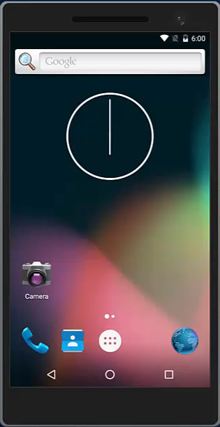
React Native Demo

Slide 12
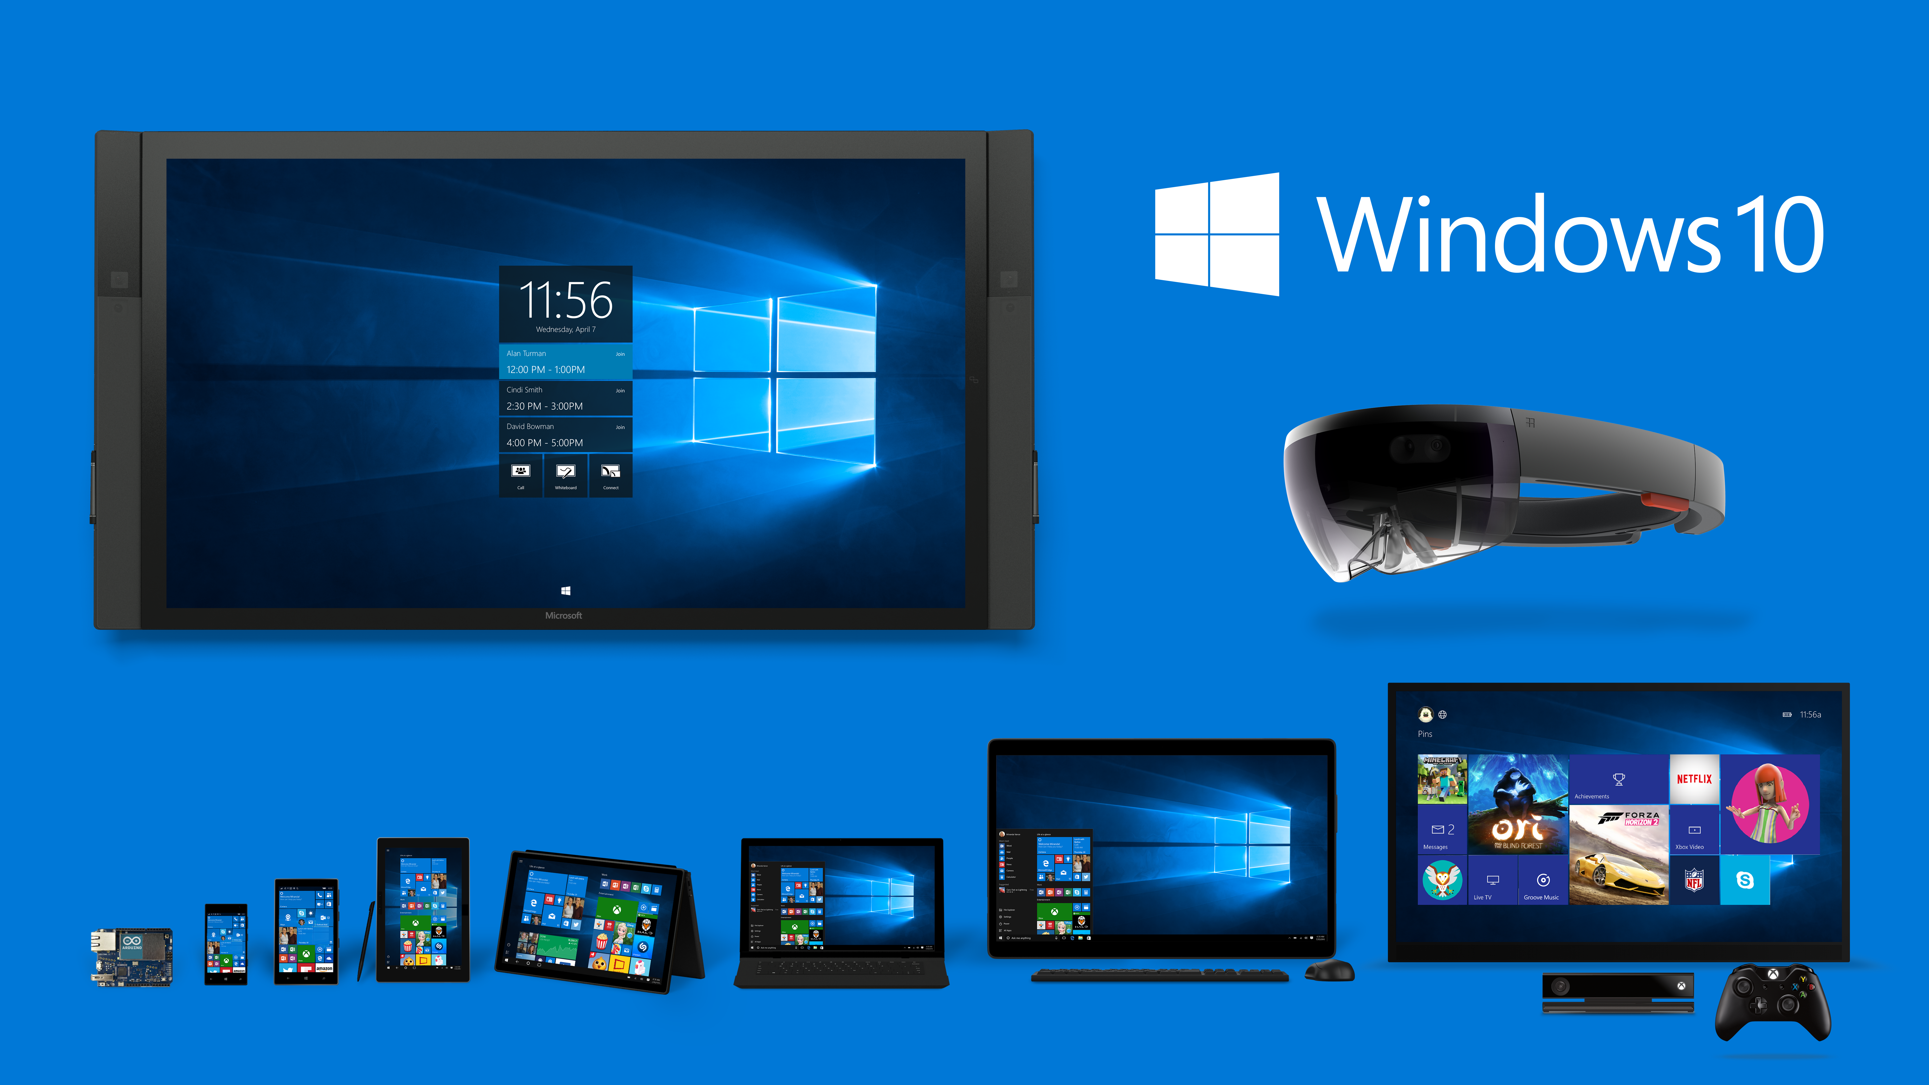

Slide 13
What language will be used?
Framework Extensibility
Platform Symmetry
Native Performance
C# (for now…)
Notes:
UWP has C# and C++/CX.
- Android offers Java Modules with reflection, we wanted the same ease of use
While could use WinRT components for C# interop with C++ core framework, certainly more complicated than...
Flipside, it‘s very easy to expose C++ libraries to C# via pInvoke or interop
On the same note, somebody needs to maintain these core native libraries, and our initial guess was that the more symmetry with ReactAndroid the better
*!*!, Clearly, C++/CX is going to win here, pooling, .NET Native compilation
Also drop into C++ for hot code paths

Slide 14
What native view framework will be used?
Web View?
Windows.UI.Composition?
Windows.UI.Xaml.UIElement ✔
public interface IViewManager
{
string Name { get; }
void UpdateProperties(
FrameworkElement viewToUpdate,
ReactStylesDiffMap props);
FrameworkElement CreateView();
void OnDropViewInstance(
FrameworkElement view);
void UpdateExtraData(
FrameworkElement root,
object extraData);
void ReceiveCommand(
FrameworkElement view,
int commandId,
JArray args);
}

Slide 15
What JavaScript runtime will be used?
var globalObject = JavaScriptValue.GlobalObject;
var requireFunction = globalObject.GetProperty(
JavaScriptPropertyId.FromString("require"));
var moduleName =
JavaScriptValue.FromString("MyModule");
var module = requireFunction.CallFunction(
globalObject,
moduleName);
var value = JavaScriptValue.CreateObject();
value.SetProperty(
JavaScriptPropertyId.FromString("foo"),
JavaScriptValue.FromInt32(42),
true);
JavaScriptContext.RunScript(
"var myModule = require('MyModule'); " +
"var value = { 'foo': 42 };");
JavaScriptCore?
Chakra ✔

Slide 16
How are the native threads managed?
JavaScript and Layout Threads
UI Thread
private readonly taskScheduler =
new LimitedConcurrencyTaskScheduler(1);
private readonly taskFactory =
new TaskFactory(taskScheduler);
public async void RunOnQueue(Action action)
{
await taskFactory.StartNew(() =>
{
try
action();
catch (Exception ex)
ShowRedBoxException(ex);
});
}
private readonly actionObservable =
new Subject<Action>();
private readonly subscription =
actionObservable
.ObserveOnDispatcher()
.Subscribe(action =>
{
try
action();
catch (Exception ex)
ShowRedBoxException(ex);
});
public async void RunOnQueue(Action action)
{
actionObservable.OnNext(action);
}

Slide 17
How is data marshalled between native and JS?
public JavaScriptValue Convert(JToken json)
{
if (json.Type == JTokenType.Array)
{
var jsonArray = (JArray)json;
var count = (uint)jsonArray.Count;
var result = JavaScriptValue.CreateArray(count);
for (var i = 0; i < count; ++i)
{
result.SetIndexedProperty(
JavaScriptValue.FromInt32(i),
Convert(jsonArray[i]));
}
return JavaScriptValue.FromString(json.Value<string>());
}
else if (json.Type == JTokenType.String)
{
return JavaScriptValue.FromString(json.Value<string>());
}
/* ... */
}

Slide 18
How is data marshalled between native and JS?
public JavaScriptValue Convert(JToken json)
{
var str = json.ToString();
var value = JavaScriptValue.FromString(str);
return JavaScriptValue.GlobalObject
.GetProperty("JSON")
.GetProperty("parse")
.CallFunction(value);
}
public JToken Convert(JavaScriptValue json)
{
var str = json.ToString();
return JToken.Parse(str);
}

Slide 19
How are native modules registered?
class FooModule : NativeModuleBase
{
public override string Name => "Foo";
[ReactMethod]
public void DoBar(string qux)
{
Debug.WriteLine($"FooBar{qux}");
}
}
class FooViewManager : SimpleViewManager<Canvas>
{
public override string Name => "Foo";
[ReactProp("Bar")]
public void SetBar(string qux)
{
/* ... */
}
protected override Canvas CreateViewInstance(
ThemedReactContext reactContext)
{
return new Canvas();
}
}
class FooJSModule : JavaScriptModuleBase
{
public void DoBar(string qux)
{
Invoke(qux);
}
}

Slide 20
How are native modules registered?
public interface IReactPackage
{
ReadOnlyList<INativeModule> CreateNativeModules(ReactContext reactContext);
IReadOnlyList<IViewManager> CreateViewManagers(ReactContext reactContext);
IReadOnlyList<Type> CreateJavaScriptModulesConfig();
}

Slide 21

What is the native developer experience?

Slide 22
Bringing F8 App to Windows
“Write once, run anywhere”
“Learn once, write anywhere”

Slide 23
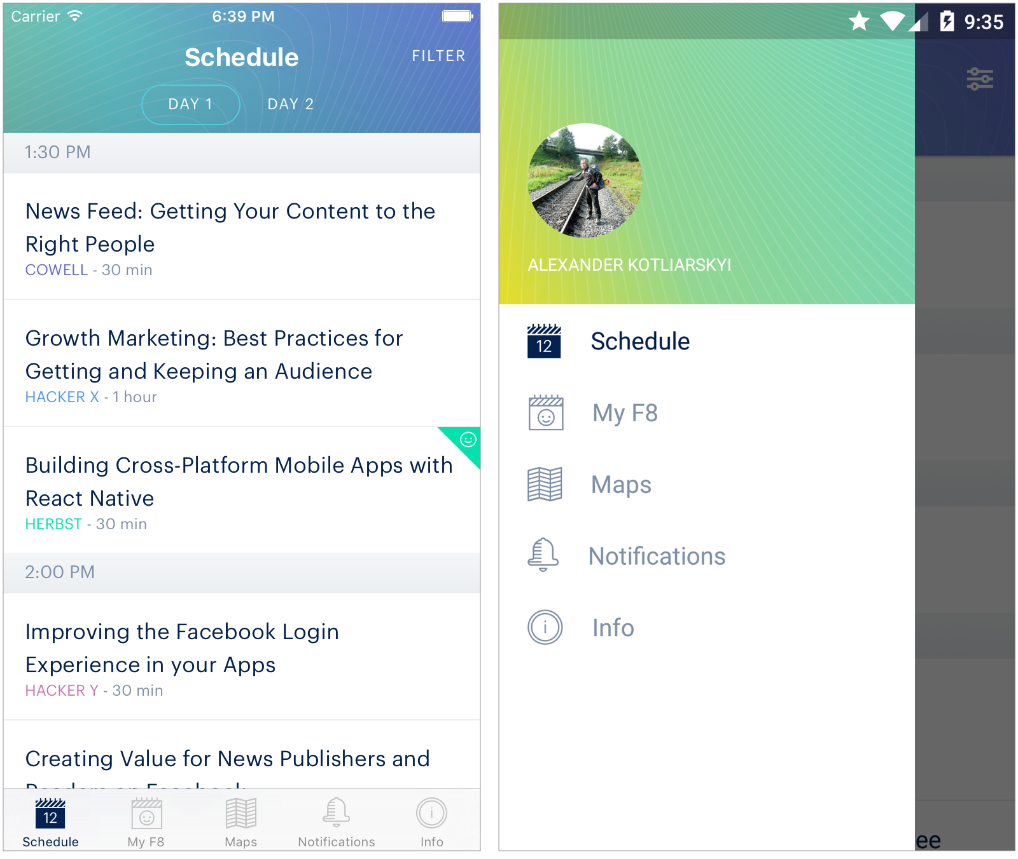
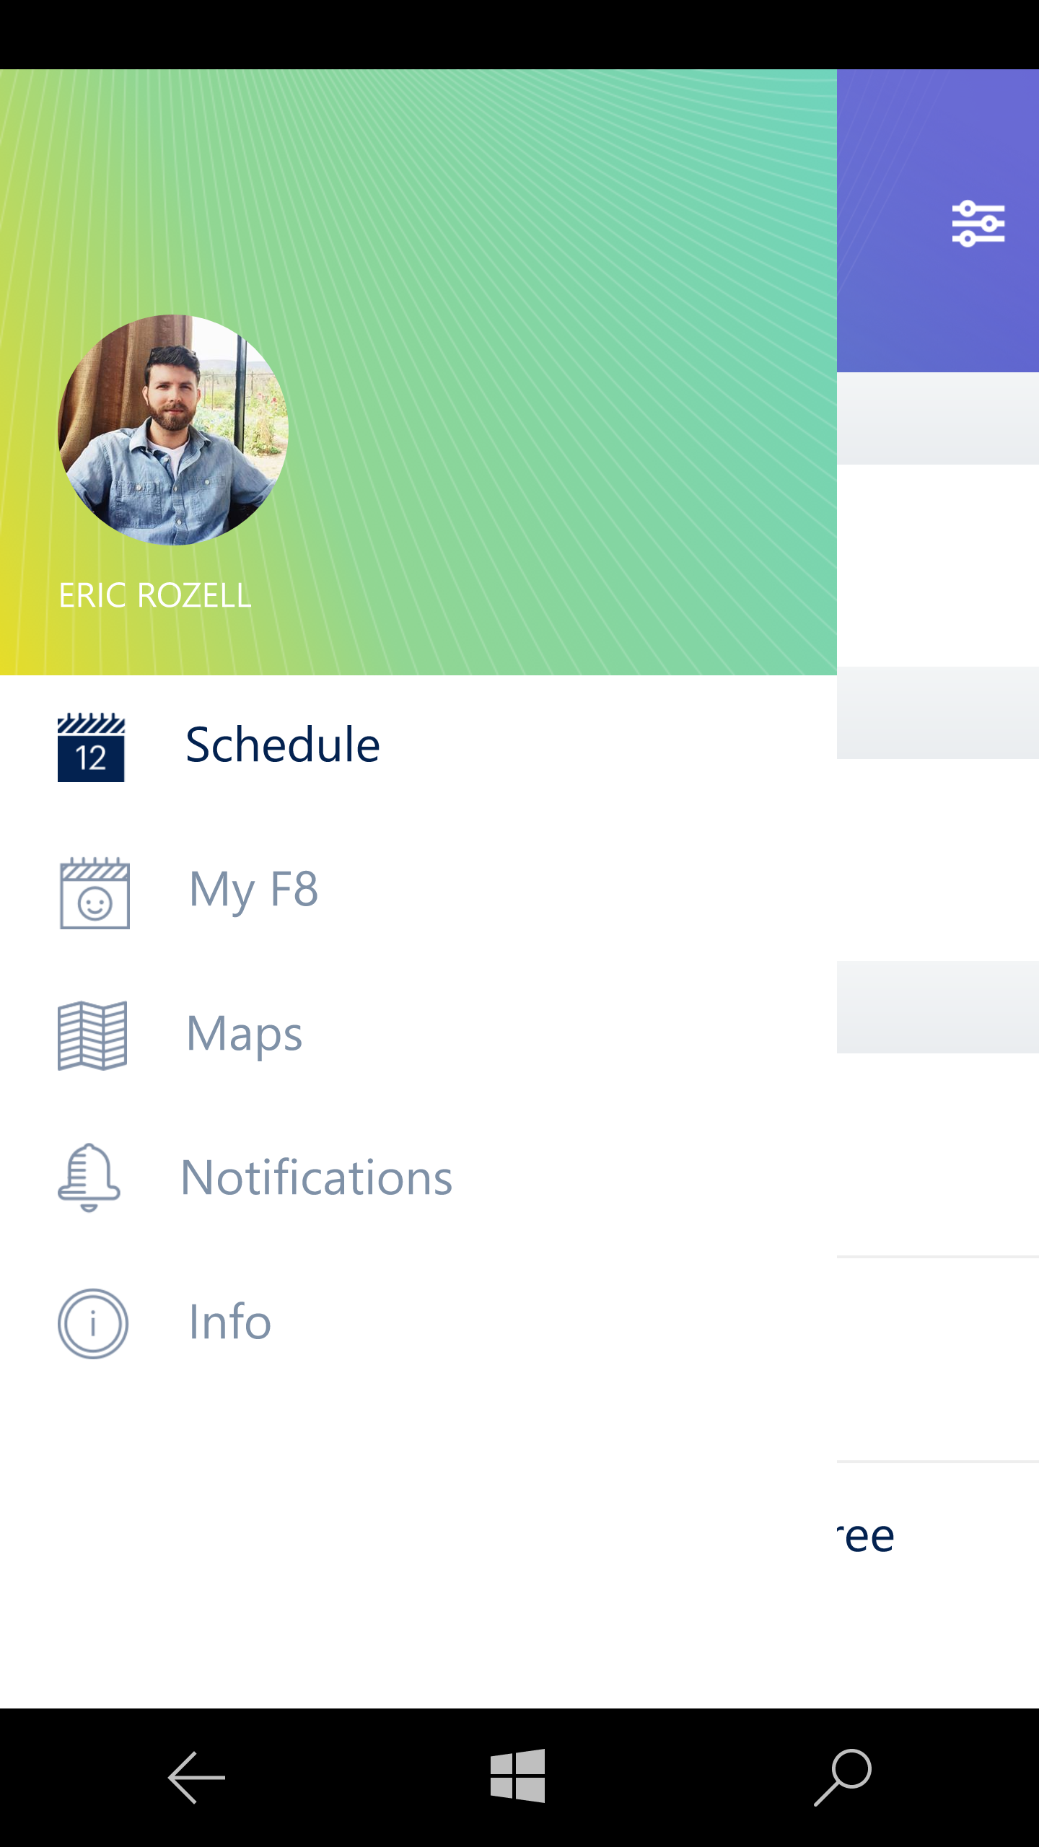
Notes:
Would be great if these could be videos.

Slide 24
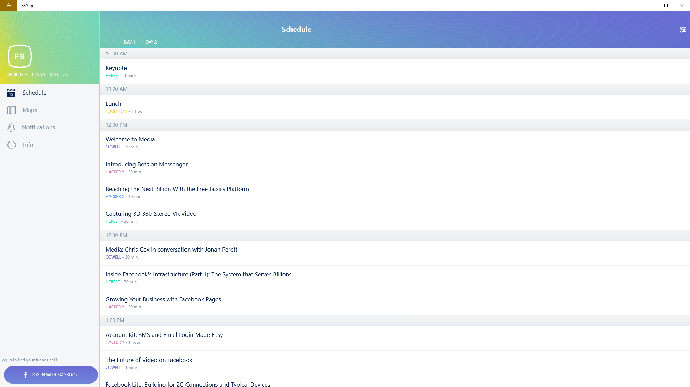

Slide 25
Bringing F8 App to Windows
3 developers, 3 weeks
Most time spent filling in missing modules…
SplitView, FlipView, Clipboard, AsyncStorage, …
react-native-fbsdk, react-native-share
< 1 week for style adaptation only

Slide 26
Bringing F8 App to Windows
var styles = StyleSheet.create({
container: {
flex: 1,
backgroundColor: 'white',
},
listView: {
ios: {
backgroundColor: 'transparent',
},
android: {
backgroundColor: 'white',
},
windows: {
backgroundColor: 'white',
}
},
headerTitle: {
color: 'white',
fontWeight: 'bold',
fontSize: 20,
},
});

Slide 27
Bringing F8 App to Windows
F8TabsView.windows.js
F8TabsView.android.js
class F8TabsView extends React.Component {
...
render() {
return (
<F8SplitView
ref="splitView"
paneWidth={290}
panePosition="left"
renderPaneView={this.renderPaneView}>
<View
style={styles.content}
key={this.props.tab}>
{this.renderContent()}
</View>
</F8SplitView>
);
}
...
}
class F8TabsView extends React.Component {
...
render() {
return (
<F8DrawerLayout
ref="drawer"
drawerWidth={290}
drawerPosition="left"
renderNavigationView={this.renderNavView}>
<View
style={styles.content}
key={this.props.tab}>
{this.renderContent()}
</View>
</F8DrawerLayout>
);
}
...
}
var styles = StyleSheet.create({
container: {
flex: 1,
backgroundColor: 'white',
},
listView: {
ios: {
backgroundColor: 'transparent',
},
android: {
backgroundColor: 'white',
},
windows: {
backgroundColor: 'white',
}
},
headerTitle: {
color: 'white',
fontWeight: 'bold',
fontSize: 20,
},
});

Slide 28
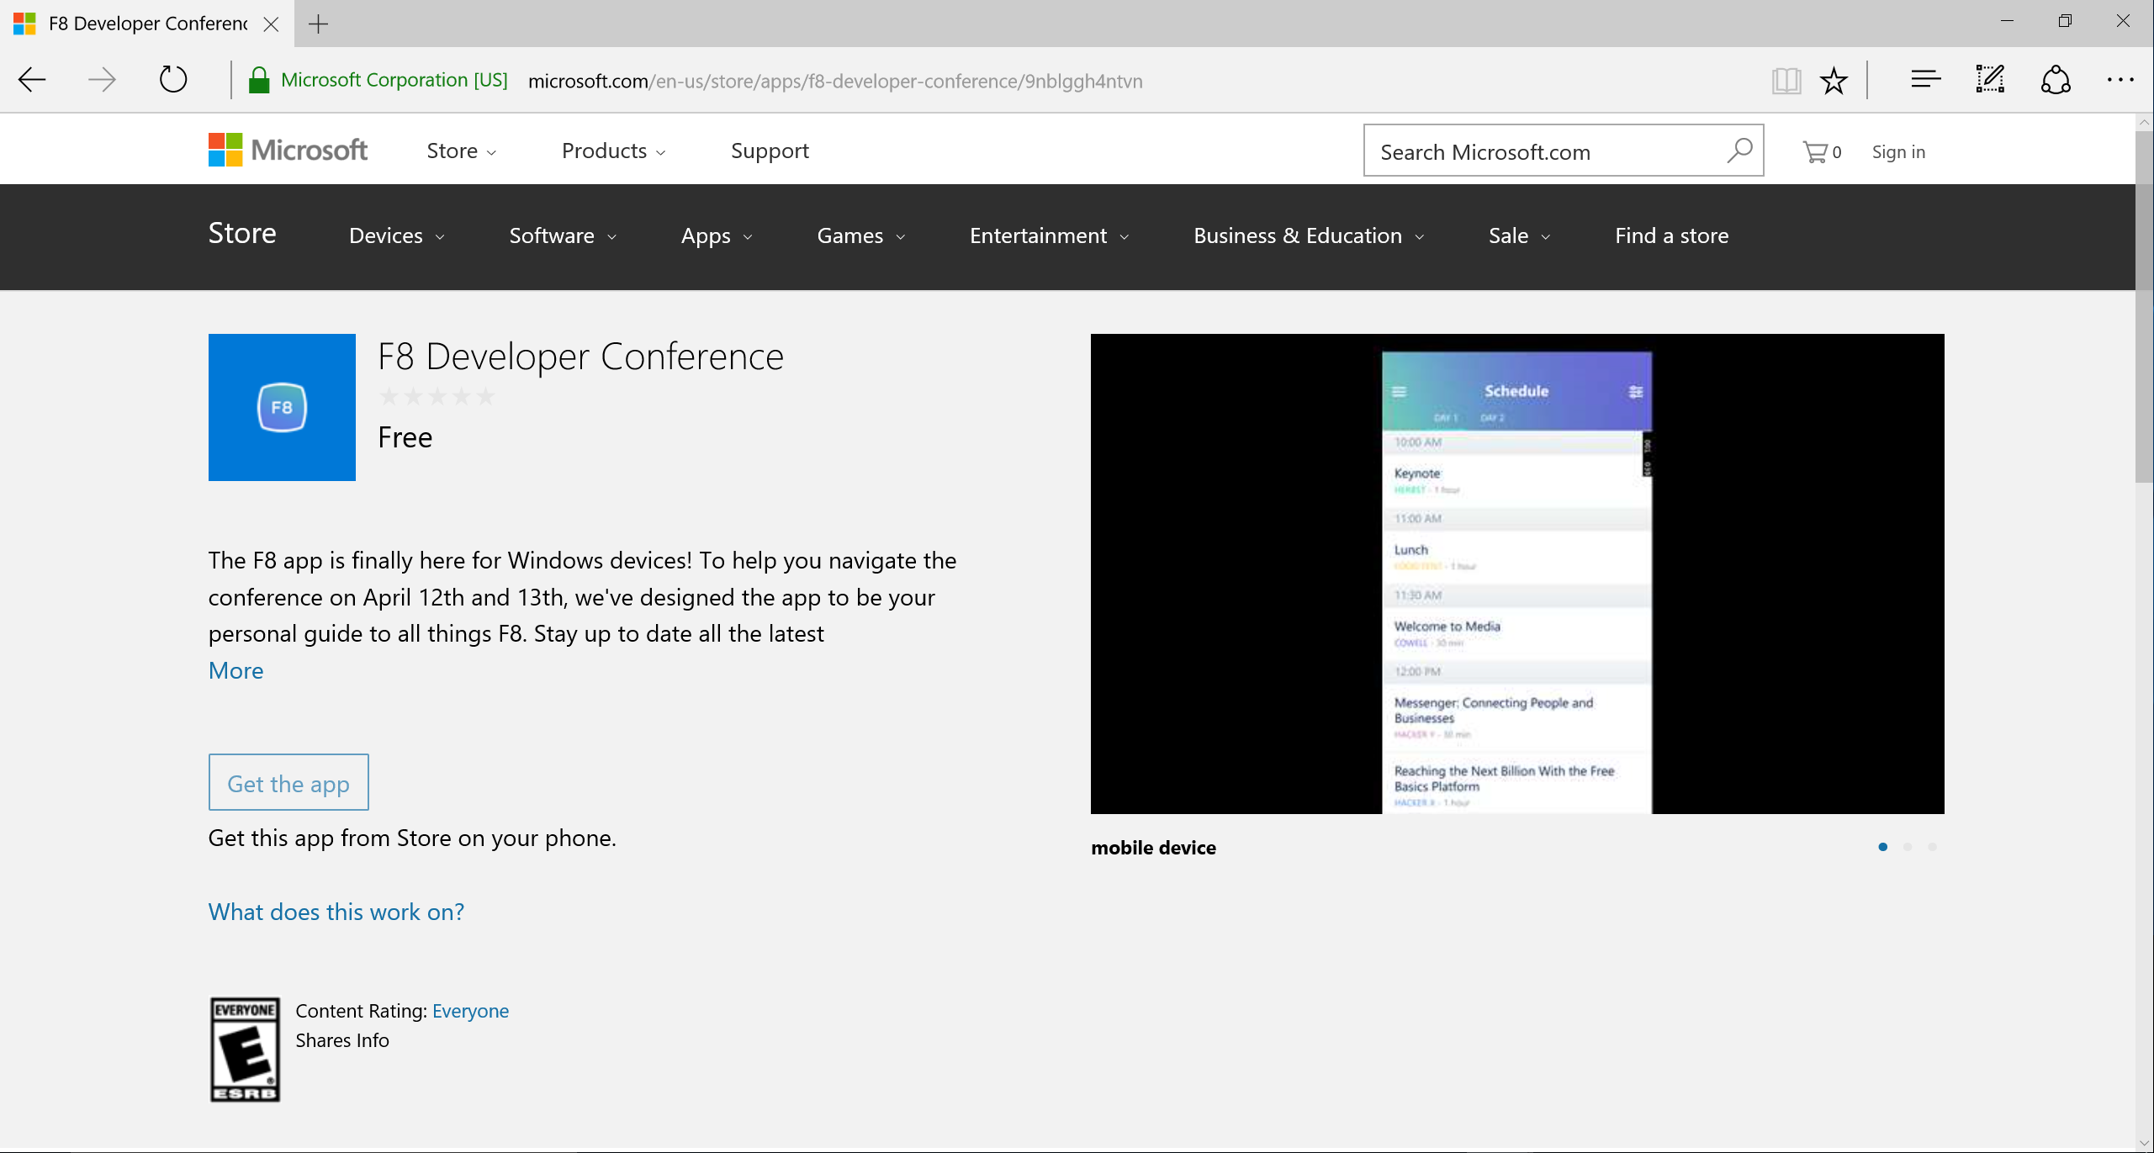
Notes:
- Some stuff about shipping on the app store
- .NET Native
- Reflection issues, JSON serializer issues, etc.

Slide 29

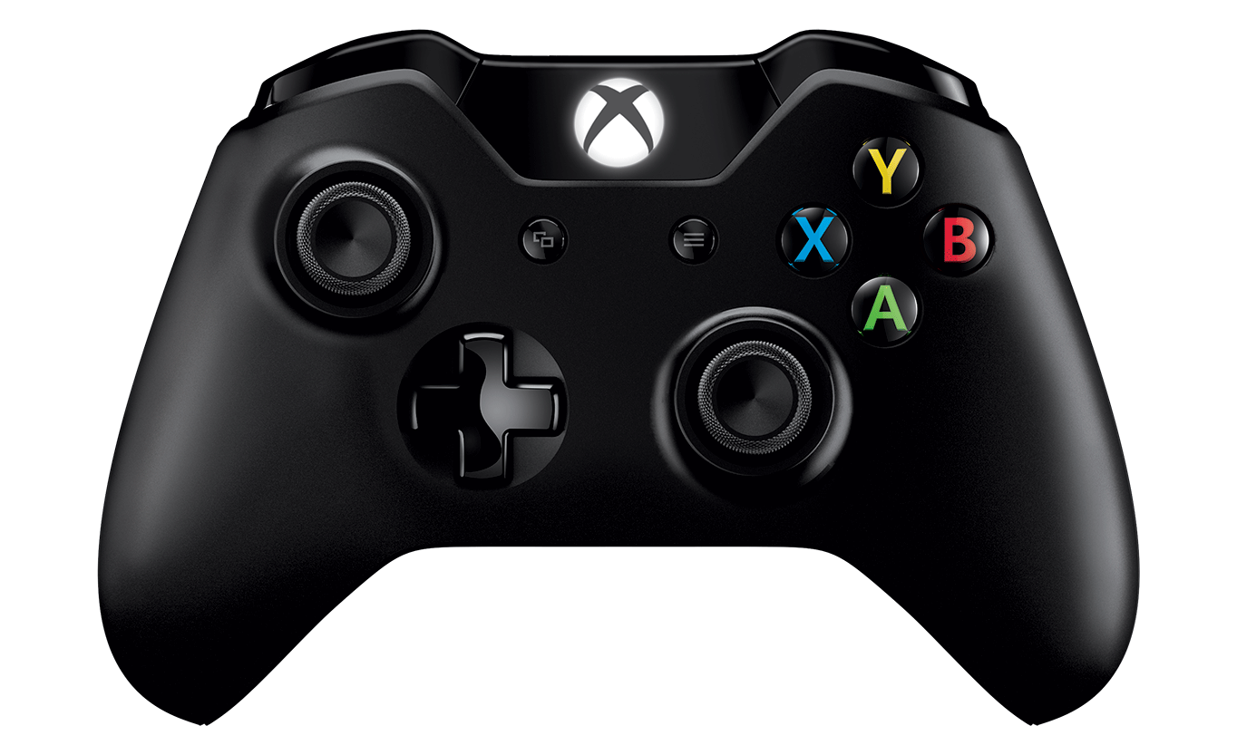
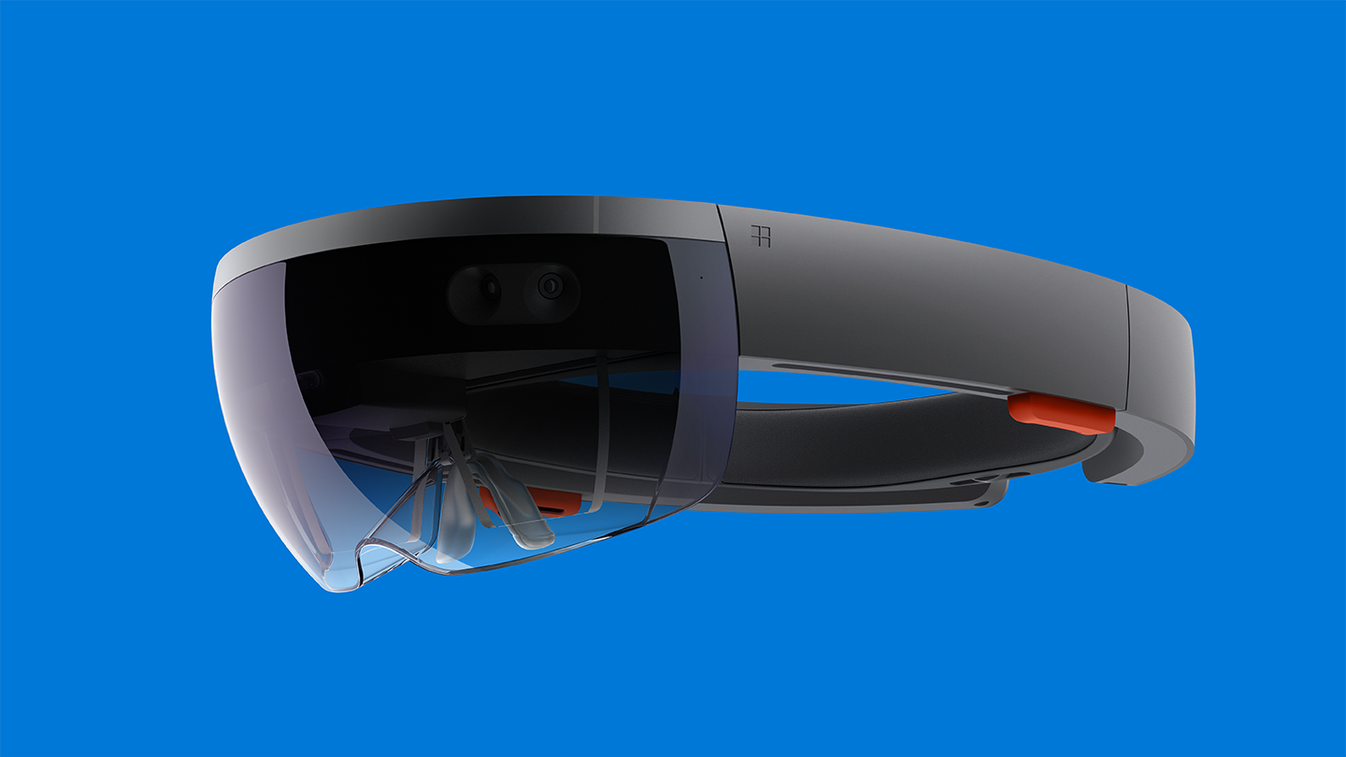

What lies ahead?
Notes:
- React Native Desktop / Xbox paradigms
- Plans for moving forward on OSS contribution
- Call to action

Slide 30
Open Source
http://github.com/ReactWindows/react-native
http://github.com/ReactWindows/f8app
@ReactWindows
Notes:
- React Native Desktop / Xbox paradigms
- Plans for moving forward on OSS contribution
- Call to action

Slide 31
Thank you!
Eric Rozell, Erik Schlegel
@ericrozell, @erikschlegel1

